Slide 1
Test Case Writing

Slide 2
Content
Testing Life cycle
Test Plan
Test Scenarios
Test cases
Examples
Practical question

Slide 3
Testing Life Cycle
Project Initiation
System Study
Analysis
Test Plan
Regression Test
Design Test Cases
Report Defects
Execute Test Cases
( manual /automated )

Slide 4

Test Plan
A test plan is a systematic approach to testing a system i.e. software. The plan typically contains a detailed understanding of what the eventual testing workflow will be.

Slide 5
Test Plan…
Testing usually starts with test plan and ends with acceptance testing
Test plan is a general document that defines the scope and approach for testing for the whole project
Inputs are SRS, project plan, design
Test plan identifies what levels of testing will be done, what units will be tested and etc.

Slide 6
Test Plan…
Test plan usually contains
  Test unit specs: what units need to be tested separately
  Features to be tested: functionality, performance, usability,…
  Approach: criteria to be used, when to stop, how to evaluate, etc
  Test deliverables
  Schedule and task allocation

Slide 7

Test case specifications
A test case is a specific procedure of testing a particular requirement.
It will include:
Identification of specific requirement to be tested
Specific steps to execute test
Parameter values for the test
expected outcome of the test

Slide 8
Test case specifications
Test plan focuses on approach; does not deal with details of testing a unit
Test case specification has to be done separately for each unit
Based on the plan (approach, features,..) test cases are determined for a unit
Expected outcome also needs to be specified for each test case

Slide 9
Test case specifications…
Together the set of test cases should detect most of the defects
Would like the set of test cases to detect any defects, if it exists
Would also like set of test cases to be small - each test case consumes effort
Determining a reasonable set of test case is the most challenging task of testing

Slide 10
Test case specifications…
The effectiveness and cost of testing depends on the set of test cases
Q: How to determine if a set of test cases is good? I.e. the set will detect most of the defects, and a smaller set cannot catch these defects
No easy way to determine goodness; usually the set of test cases is reviewed by experts
This requires test cases be specified before testing – a key reason for having test case specs
Test case specs are essentially a table
Testing

Slide 11
Test Case Name | TC_YM_001
Test Script Description | The objective of this Test script is to check whether the user is successfully able to log in the yahoo mail and check the e-mail .
Components Tested | Login form page and Inbox module of yahoo website are tested
Entry Criteria | Computer should be connected to the Internet. Yahoo website http://mail.yahoo.com/ should be accessible.
Pass Criteria | All steps should be Pass.
Tester Name: |  | Start Time:
Test Date: |  | End Time:
Comments:
Pass (Yes / No):
Test ID | Description | Action | Test Inputs | Expected outcome | Actual outcome | Result | Comments

Slide 12
Functional Testing
The process of checking the behavior of the application.
It is geared to functional requirements of an application.
To check the correctness of outputs.

Slide 13
How to choose good functional test cases?
  Test all possible outputs
  Test both valid and invalid inputs
  Test around boundaries
  Test extreme values
  Test input syntax
  Guess at possible errors

Slide 14
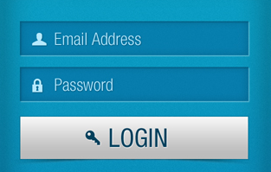
Test case scenarios/test cases

Slide 15
?
Do You Have
Any Questions?
?
?

Slide 16
Group activity
Create manual test cases for the given interfaces
Account creation
User Authentication
Compose an email

Slide 17
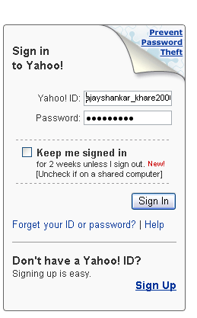

Slide 18
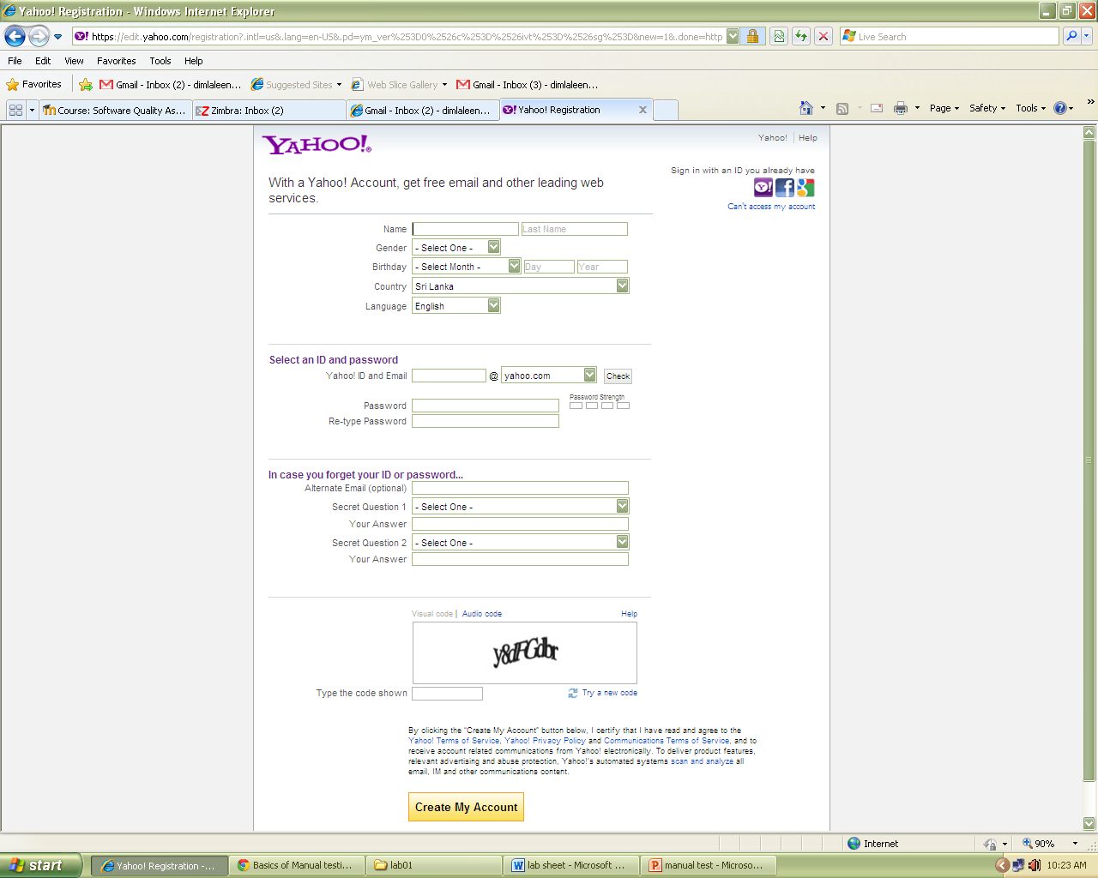

Slide 19
